Slide 1
Keeping up with the Commodore
1980s performance optimization lessons still applicable today
Dennis Dietrich Manager Software Development ICS, Phoenix Contact
Rev. 1 (2025-??-??), https://github.com/dennisdietrich/KeepingUp/

Slide 2

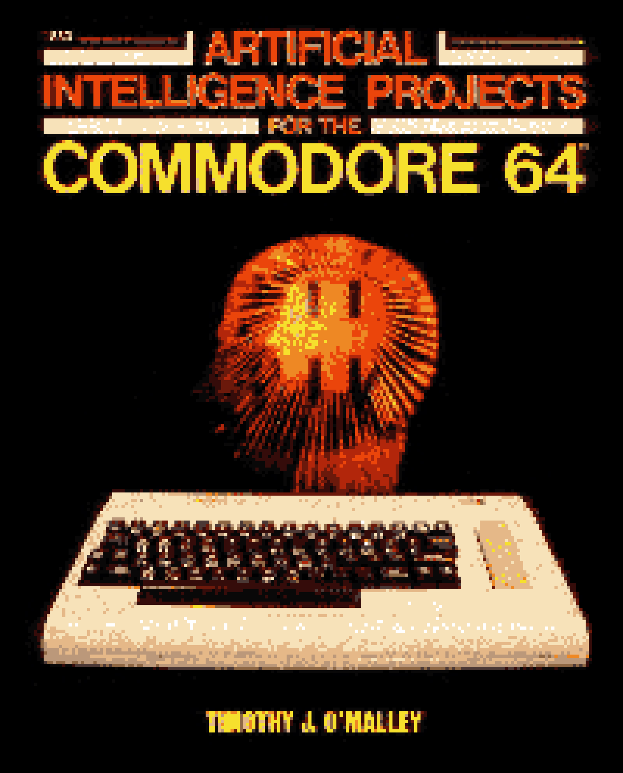
**** COMMODORE 64 BASIC V2 ****
64K RAM SYSTEM 38911 BASIC BYTES FREE
READY.
Keeping up with the Commodore
1980s performance optimization
lessons still applicable today
Dennis Dietrich
Manager Software Development ICS
Phoenix Contact

Slide 3

Lessons of Hanoi

Slide 4
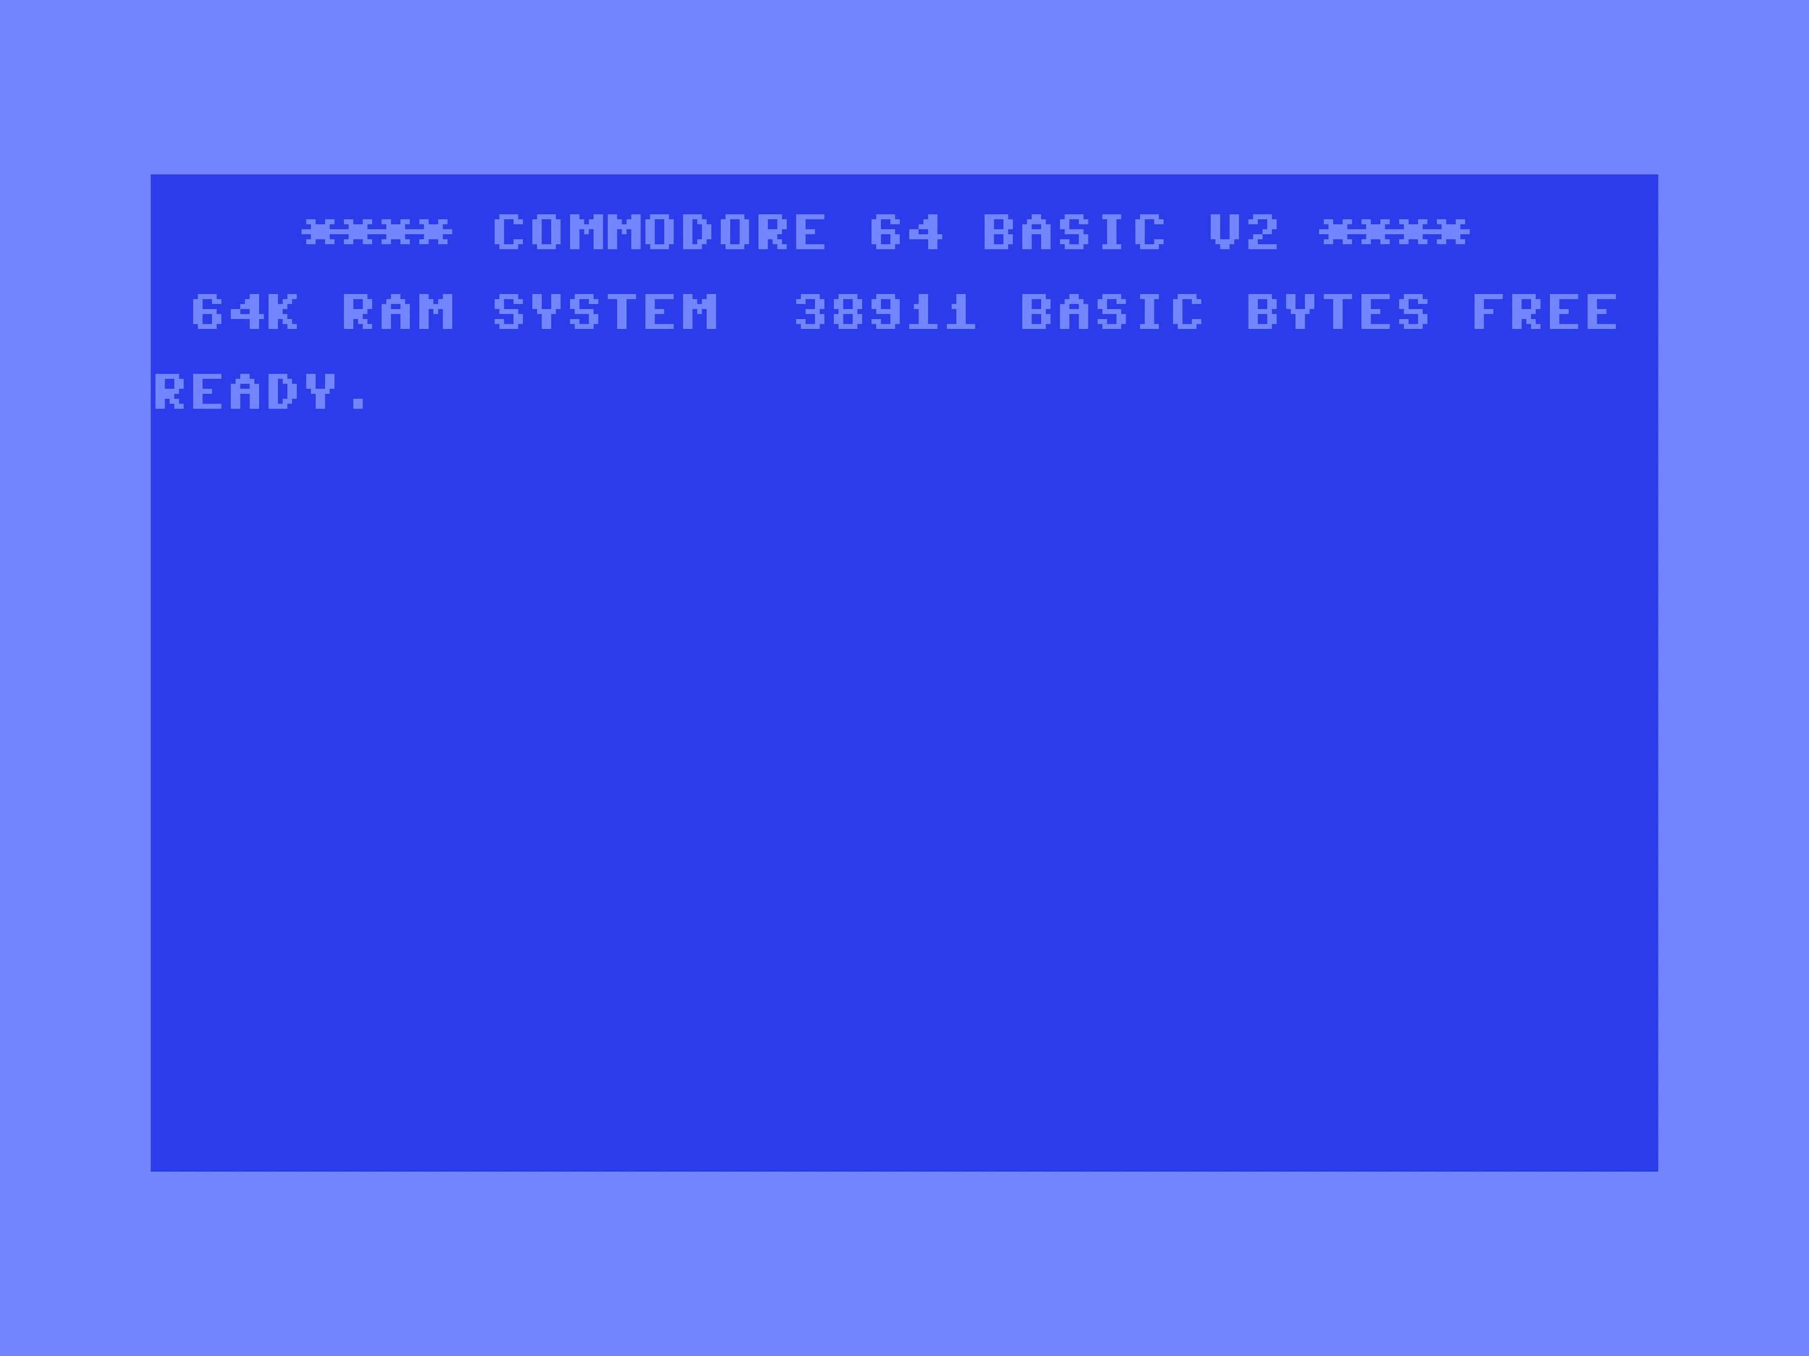

Slide 5
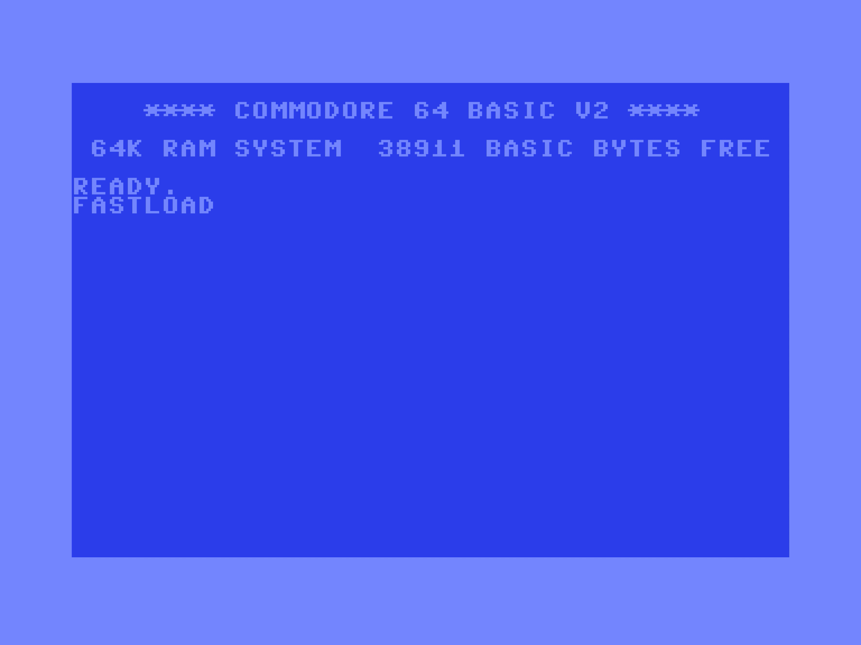

Slide 7
Lessons of Hanoi

Slide 8



Questions?
dennisdietrich
dcdietrich
@dc@social.advancedsoftware.engineering

Slide 9

Thanks for listening!
dennisdietrich
dcdietrich
@dc@social.advancedsoftware.engineering

